Slide 1

Sentiment Analysis of Twitter Data for predicting Apple stock price
Group4
Amit Sharma, Mihir Mehta, MANJARI SHUKLA, Richard Yoo

Slide 2


WHY Twitter?
Core Message
To analyze how Twitter sentiment affects the price of Apple stock (“AAPL”)
Twitter is a rich source of real-time information regarding current societal trends and opinions.

Slide 3



Data & Models
Twitter Data: Data from Kaggle (https://www.kaggle.com/nadun94/twitter-sentiments-aapl-stock)
Stock Data: Stock Price of Apple from Yahoo Finance.
Machine Learning Models: Time Series Models, LSTM and XG Boost to fit the data and compare performance between models.
Data Visualization: hvPlot and Matplotlib.

Slide 4
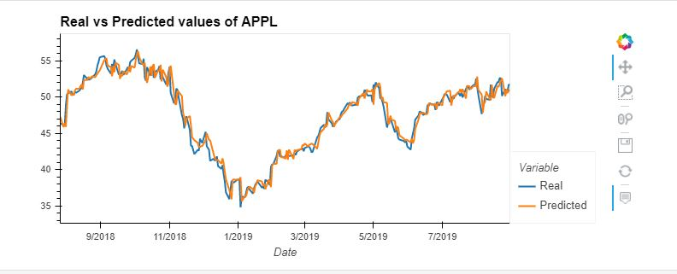
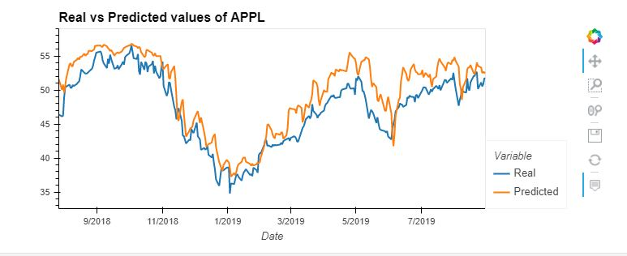
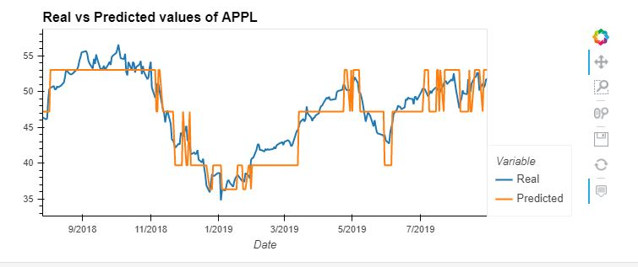
Model Summary <Regression Approach>
XG Boost
LSTM
Random Forest Regressor
XG Boost
LSTM
RF Regressor

Slide 5
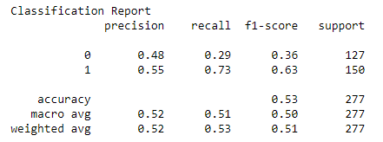
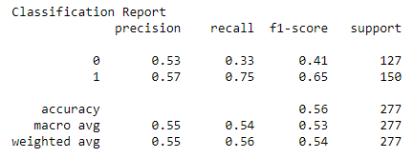
Model Summary <Classification Approach>
RF Classifier
Random Forest Classifier
Gradient Booster
Gradient Booster

Slide 6
Summary/Conclusions/Predictions
Was the model sufficient for the predictive task?
What inferences or general conclusions can you draw from your model performance?

Slide 7

Problems/Issues during data preparation and model training
Data preparation:
1) Getting AAPL stock data
2) Getting Twitter Data with “ts_polarity” and “twitter_volume”
3) Getting Twitter Data using Tweepy Library
Model Training: (???)
1) Selecting proper/ideal window size
2) window_data function
3) Model fitting

Slide 8
Postmortem
Any Difficulties?
Finding Twitter Data
Machine Learning Models
Visualization
If we had 2 more weeks!!
Tweepy API/Library
News API headlines besides Twitter
New API/Libraries
More Machine Learning Models
More visualizations

Slide 9


